Slide 1
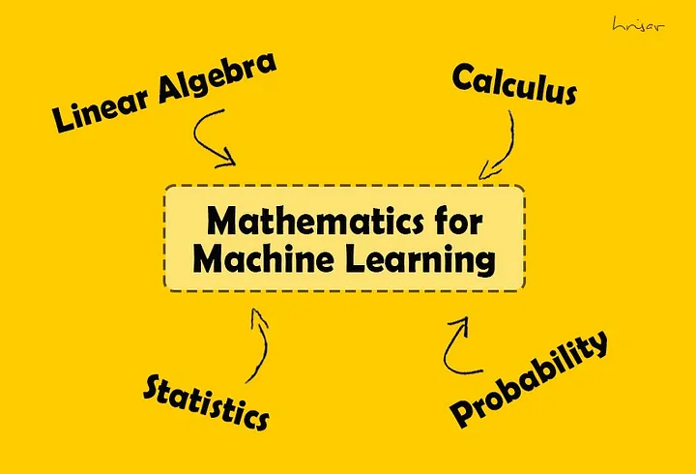

Slide 2
Linear Algebra
“To make a skyscraper the foundation has to be strong.”

Slide 3
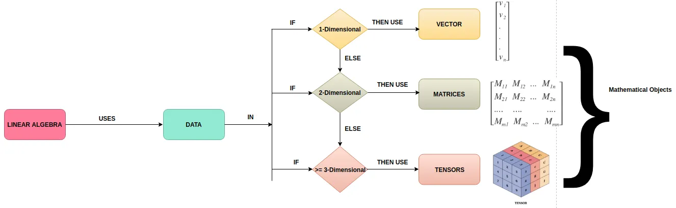

Slide 4


Machines or computers only understand numbers. And these numbers need to be represented and processed in a way that lets machines solve problems by learning from the data instead of learning from predefined instructions (as in the case of programming).

Slide 5

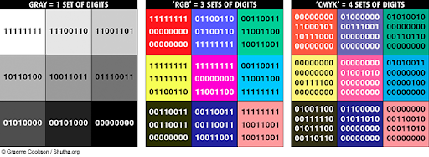

Slide 6
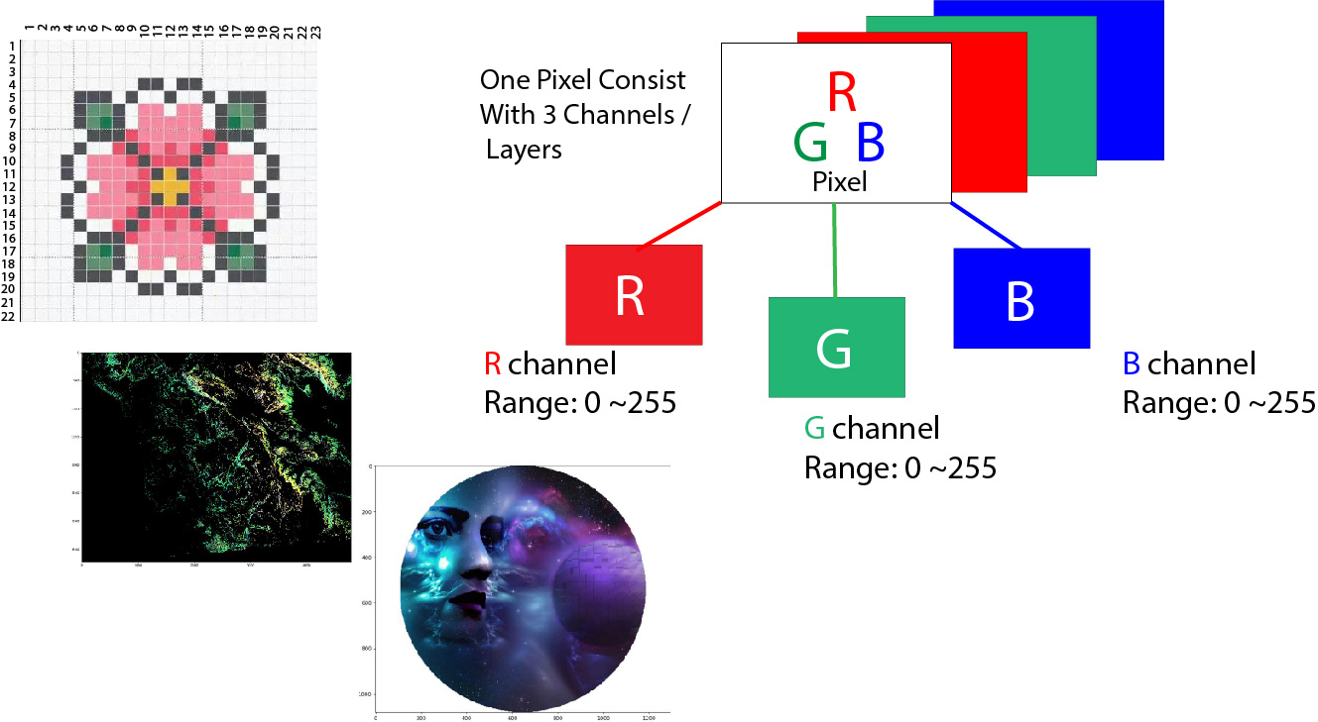

Slide 7
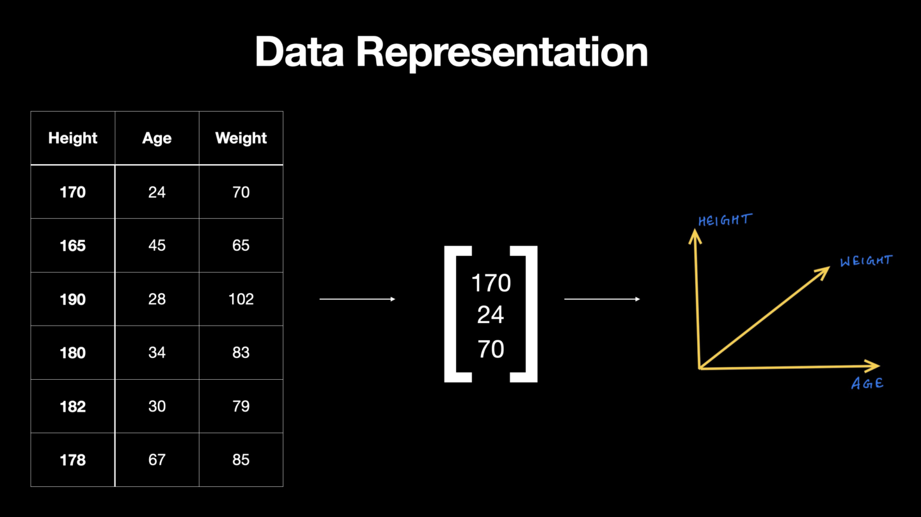

Slide 8
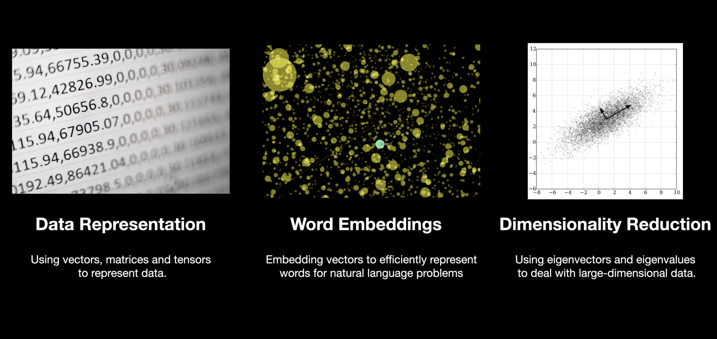

Slide 9
Vector Space
A vector space in linear algebra is a set of objects called vectors that can be added and multiplied by numbers called scalars. Vector spaces are also known as linear spaces.
Examples:
Matrices
Functions

Slide 10
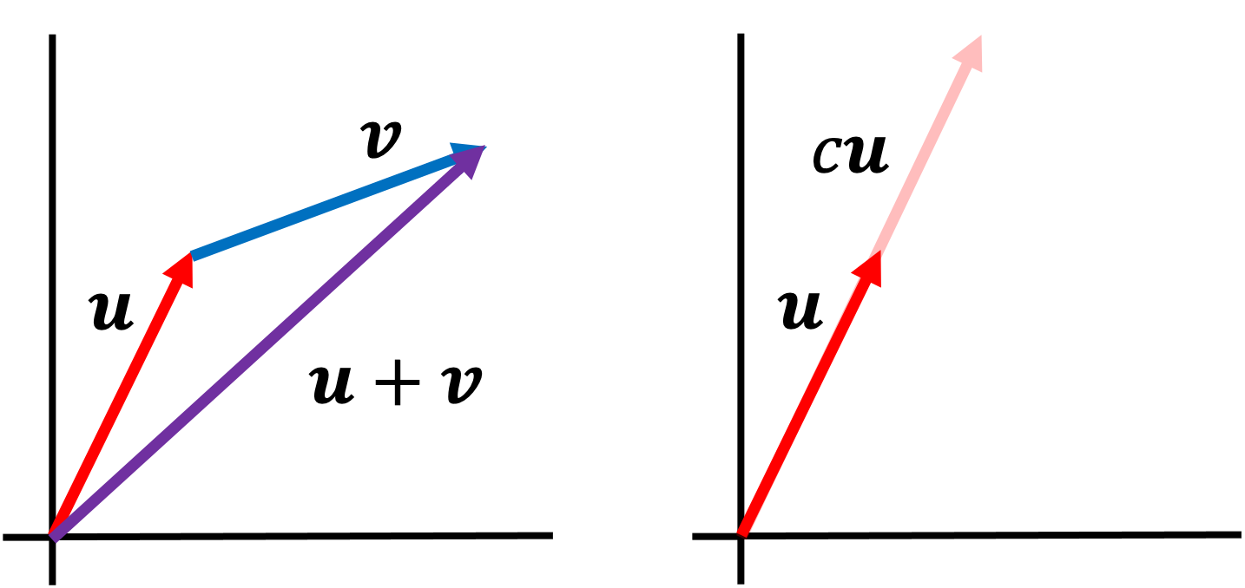

Slide 11
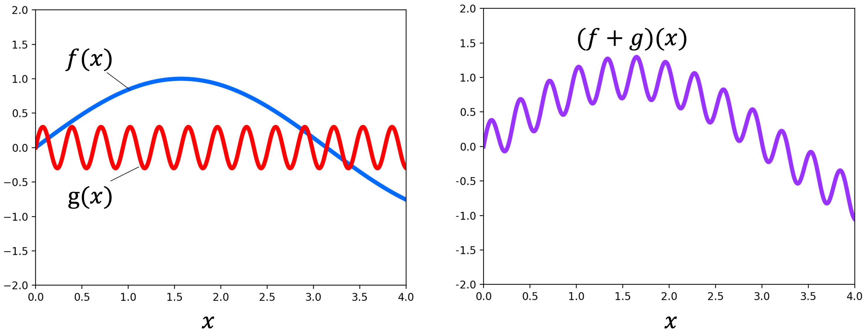

Slide 12
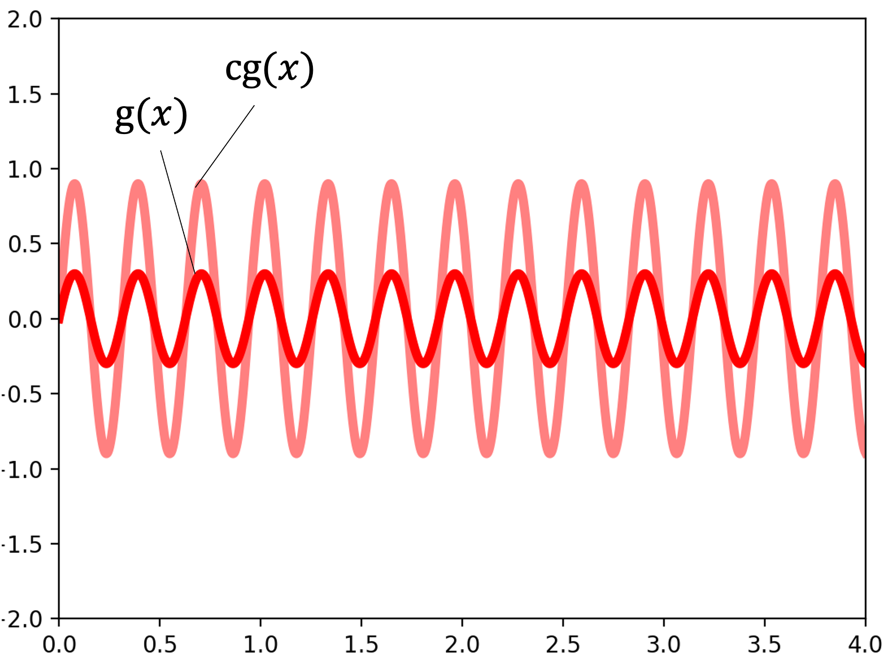

Slide 13
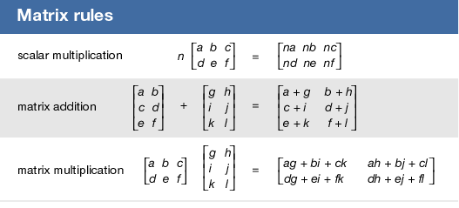

Slide 14
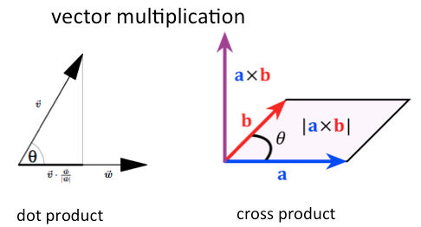

Slide 15
Dot Product Vs Cross Product
The key difference between a dot product and a cross product of vectors is that a dot product results in a scalar value (a single number)
while a cross product results in a new vector that is perpendicular to both original vectors
essentially, the dot product measures how much two vectors align,
while the cross product measures how much they are perpendicular to each other.

Slide 16
Linear vs Non-Linear Systems

Slide 17
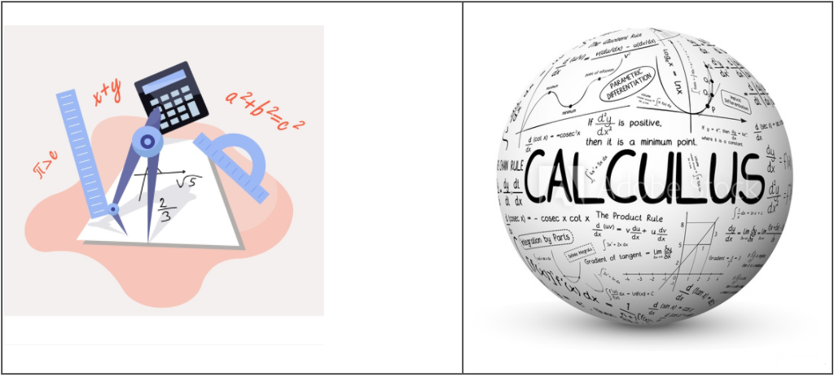

Slide 18
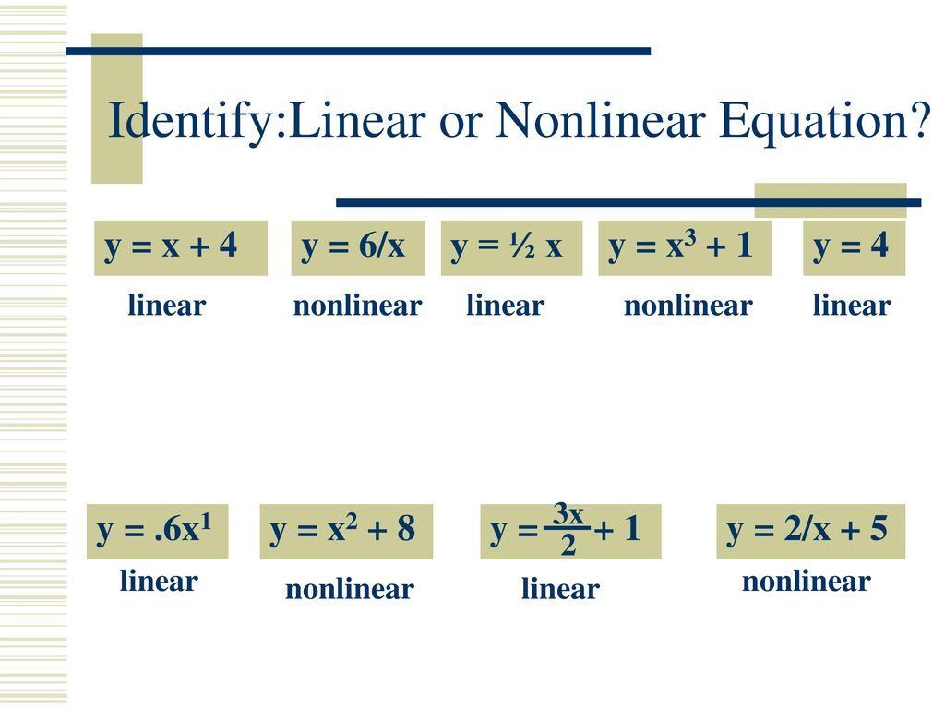

Slide 19
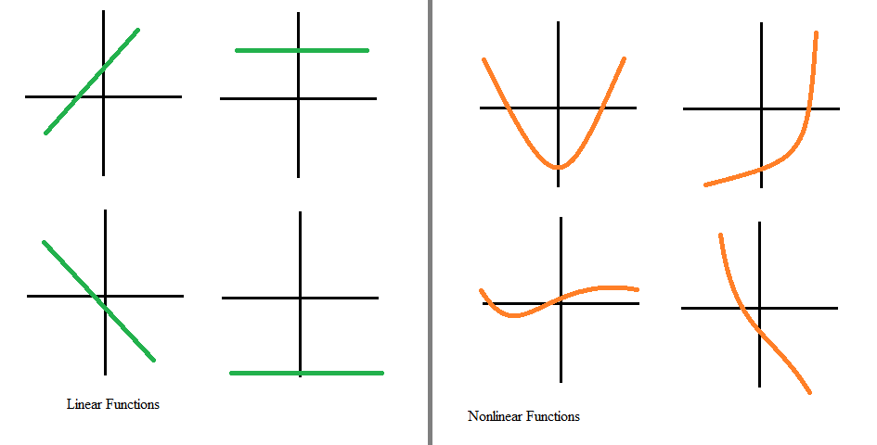

Slide 20
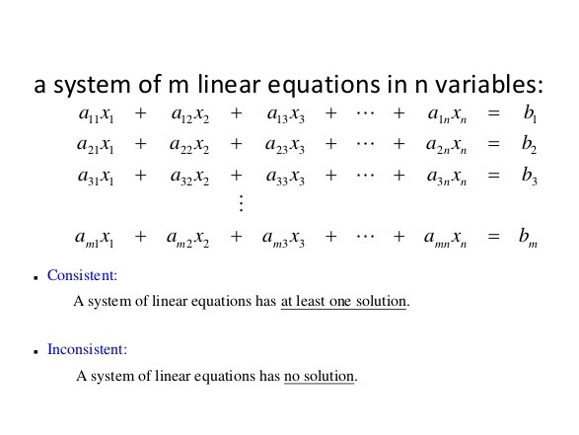
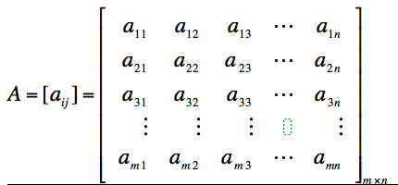

Slide 21
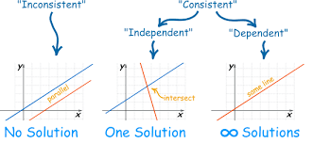
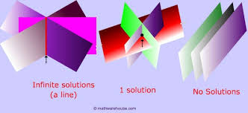

Slide 22
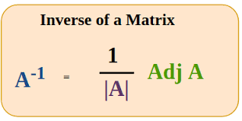
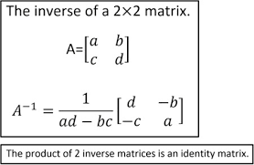

Slide 23
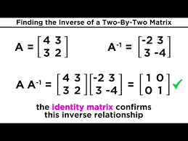

Slide 24
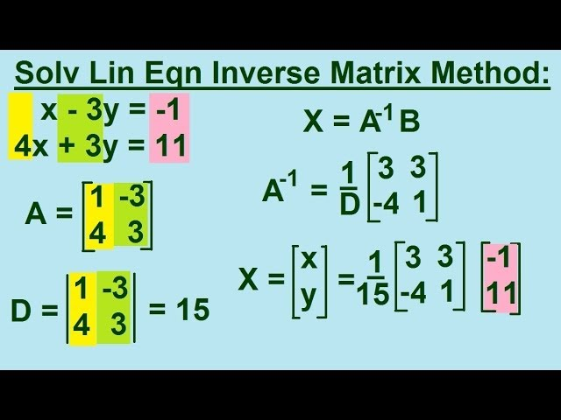

Slide 25
Transformations

Slide 26
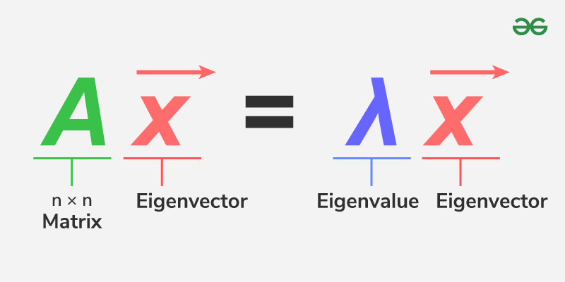
Eigenvectors are the directions that remain unchanged during a transformation, even if they get longer or shorter. Eigenvalues are the numbers that indicate how much something stretches or shrinks during that transformation.

Slide 27
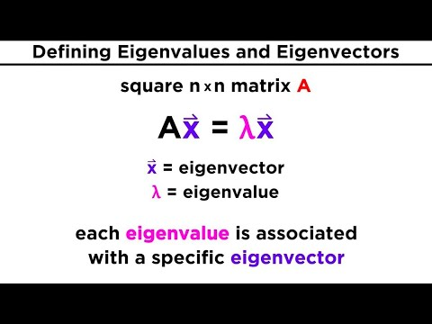

Slide 28
NumPy Linear Algebra
https://numpy.org/doc/2.1/reference/routines.linalg.html

Slide 29
Matrix and Vector Products
dot()- it can calculate the dot product of two arrays
vdot()- it can calculate the dot product of two vectors
inner()- it can calculate the inner product of arrays
outer()- it can compute the outer products of two arrays
matmul()- it can determine the matrix multiplication of two arrays
det()- it can calculate determinant of a matrix
solve()- it can solve linear matrix equation
inv()- it can calculate the multiplicative inverse of the matrix
trace()- it calculates the sum of diagonal elements
rank()- it returns the rank of the matrix

Slide 30
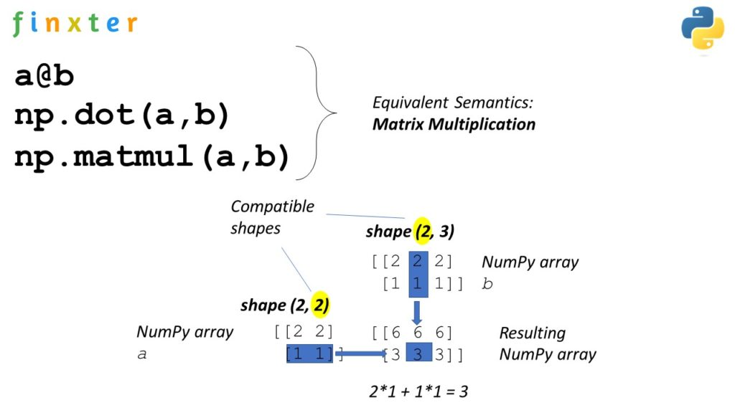

Slide 31
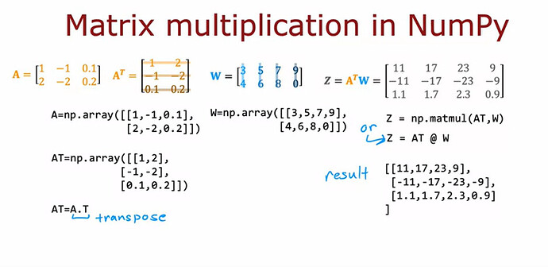

Slide 32
Calculus

Slide 33
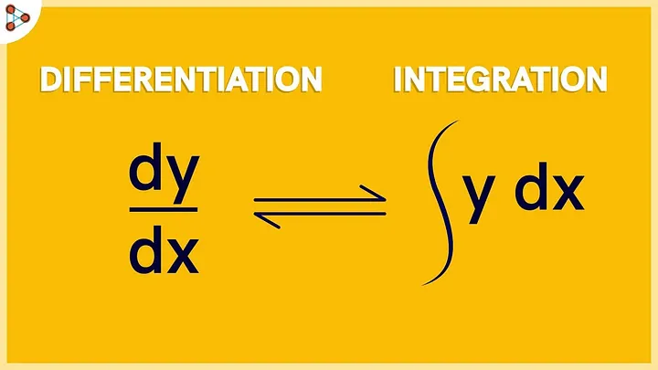

Slide 34
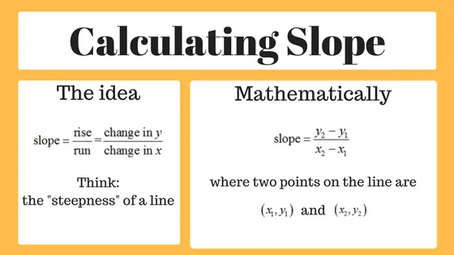

Slide 35
Which NumPy function is used to compute the dot product of two arrays?
np.multiply()
np.dot()
np.matmul()
np.linalg.dot()

Slide 36
Which function is used to compute the determinant of a matrix?
np.linalg.det()
np.determinant()
np.linalg.inv()
np.linalg.eig()

Slide 37
Which function is used to compute the eigenvalues and eigenvectors of a matrix?
np.linalg.inv()
np.linalg.eig()
np.linalg.norm()
np.linalg.svd()

